Slide 1

Stress And Depression Detection By Chatbot
by
Deepika Reddy B
Roll No. 204G1A3208
Rekha P
Roll No. 204G1A3242
Likhitha B
Roll No. 204G1A3226
Leela Krishna N
Roll No. 204G1A3225
Under the guidance of
Mr. Nazeer Shaik _{M. Tech. (ph.d)}
Assistant Professor
Department of Computer Science and Engineering (Data Science)
Srinivasa Ramanujan Institute of Technology
(Affiliated to JNTUA & Approved by AICTE) (Accredited by NAAC with ‘A’ Grade & Accredited by NBA (EEE, ECE & CSE)
Rotarypuram Village, B K Samudram Mandal, Ananthapuramu – 515701.
2023 - 2024

Slide 2
Abstract
Nowadays, stress and depression have become a growing problem for society due to their high impact on individuals’ performance. As per the statistics of Mental Health Foundation, 50% of adults who felt stressed reported feeling depressed. Therefore, it is essential to provide a service that can identify people with stress and depression at an early stage to avoid potential crisis. Few studies have shown the effectiveness of text analysis in detecting emotions and mental illness. There are few solutions for this problem to get solved individually. We aim to integrate by adding small enhancements to detecting stress and depression by processing a few statistical data, also considering a few attributes like electrocardiogram, heart rate, respiration etc. and textual data obtained by answering the questions on the chatbot. In this approach, we use word-level division and analysis of words for detecting the symptoms of stress and depression in an individual. We use a few machine learning algorithms and AI to create this Stress and Depression Detection Chatbot (SDDC) with some increase in accuracy. Keywords: Machine learning, Artificial Intelligence, electrocardiogram, heart rate, Chatbot.

Slide 3

Contents
Abstract
Problem statement
Objectives of Project
Literature survey for first objective
Literature survey for second objective
Proposed Work -(Methods to be followed for proposed system)
References
GitHub Link
Queries

Slide 4
Introduction
Point 1
Point 2
Point 3
Point 4
Point 5
Point n

Slide 5
Existing System
Point 1
Point 2
Point 3
Point 4
Point 5
Point n

Slide 6
Proposed System
Point 1
Point 2
Point 3
Point 4
Point 5
Point n

Slide 7
Reference
[1]. Author 1, Author 2 and Author 3, “Title of the Paper”,” Journal name where the paper published, vol. 11, pp. 11-15, Jan. 2020.
Use Mendeley software

Slide 8
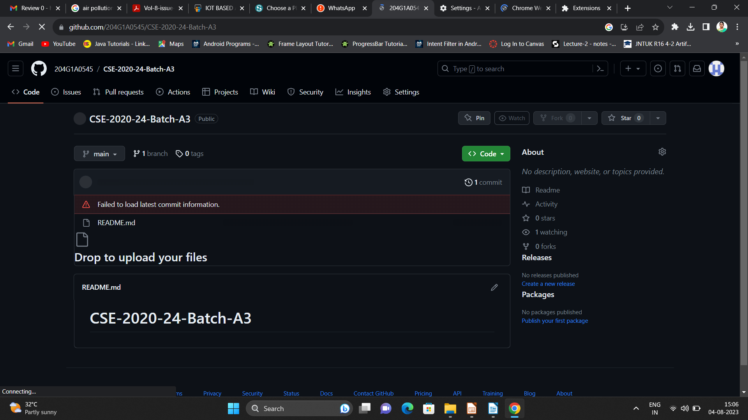

Git Hub Dashboards of each student
Repository Name Like: CSD 2023 – 24 Batch: A – XX
Under that project data upload literature survey papers, and son on..

Slide 9
Any Queries?

Slide 10
Thank You!!!

